Slide 1
Instructions for NISAR Solid Earth Sciences Users of NISAR On-Demand System
v.2025-8-20

Slide 2
CONTENTS
Instruction 0: Help
Instruction 1: OnDemand System Login
Instruction 2: OnDemand Server Start
Instruction 3: JupyterLab Home Screen
Instruction 4: Open UNIX Terminal
Instruction 5: Install/Update Back-End Code
Instruction 6: Configure Python Environment
Instruction 7: Run ARIA_prep
Instruction 8: Run Secular Requirement Validation Notebook

Slide 3
Instruction 0: Help
For any and all help for the NISAR On-Demand system, email: nisar-ondemand-help@jpl.nasa.gov

Slide 4
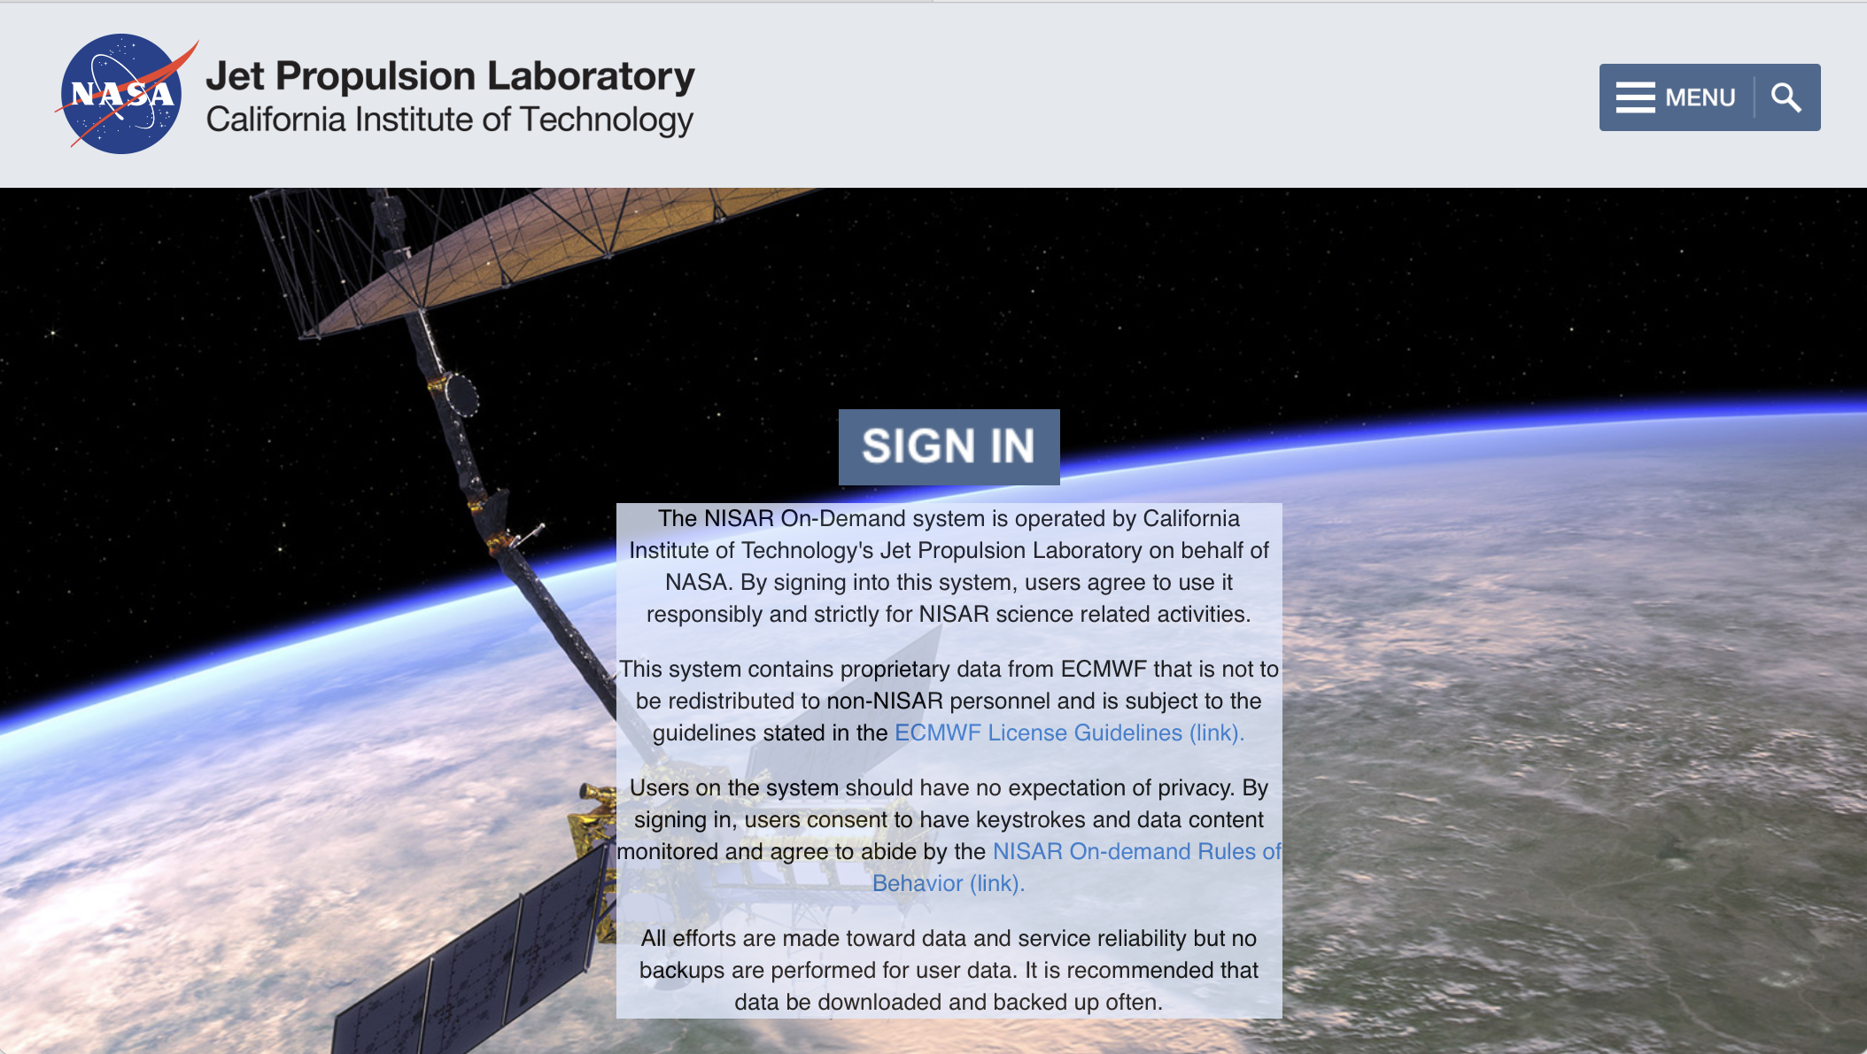
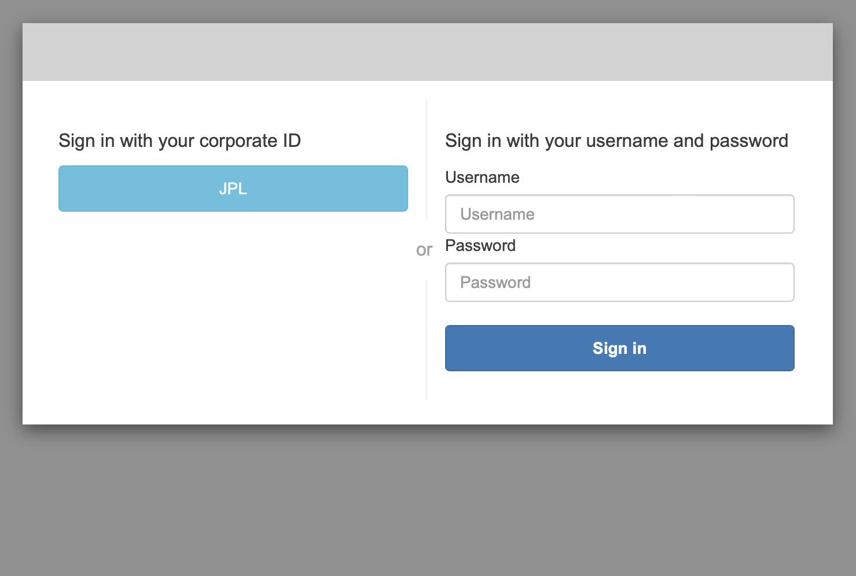
Instruction 1: OnDemand System Login
1a.) Link to On-Demand system here: https://nisar.jpl.nasa.gov/ondemand/hub/login
1b.) Click "SIGN IN" in the middle of the page. You will have to provide your user credentials in a new page (below-right) if this is a new login from this computer.

Slide 5
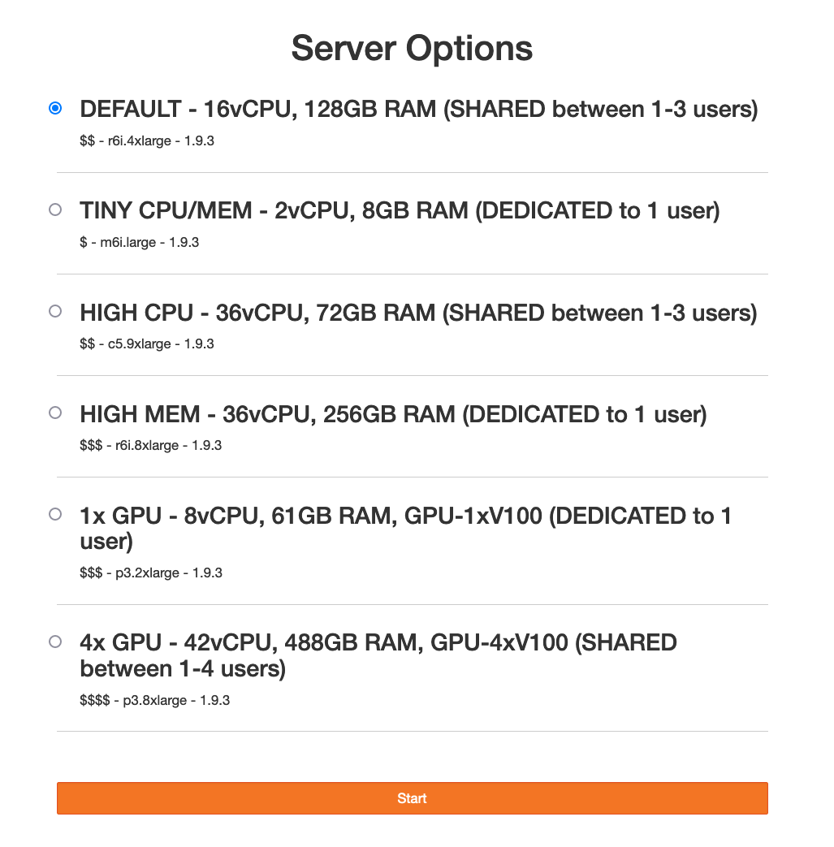
Instruction 2: OnDemand Server Start
2.) Assuming you had shut down your on-demand server previously,there will be menu of servers. You can choose the option that best fits your needs, but if you are not sure, click on the first option (DEFAULT – 16vCPU, 128GB RAM) and push the orange start bar.
Note: if you did not shut down your server during your previous session, you will be delivered directly to your already running instance. Proper shut-down requires: 1) clicking on the “Hub Control Panel” item in the File menu, 2) clicking the red “Stop My Server” button, 3) clicking ”Logout” on the top right when the window refreshes.

Slide 6
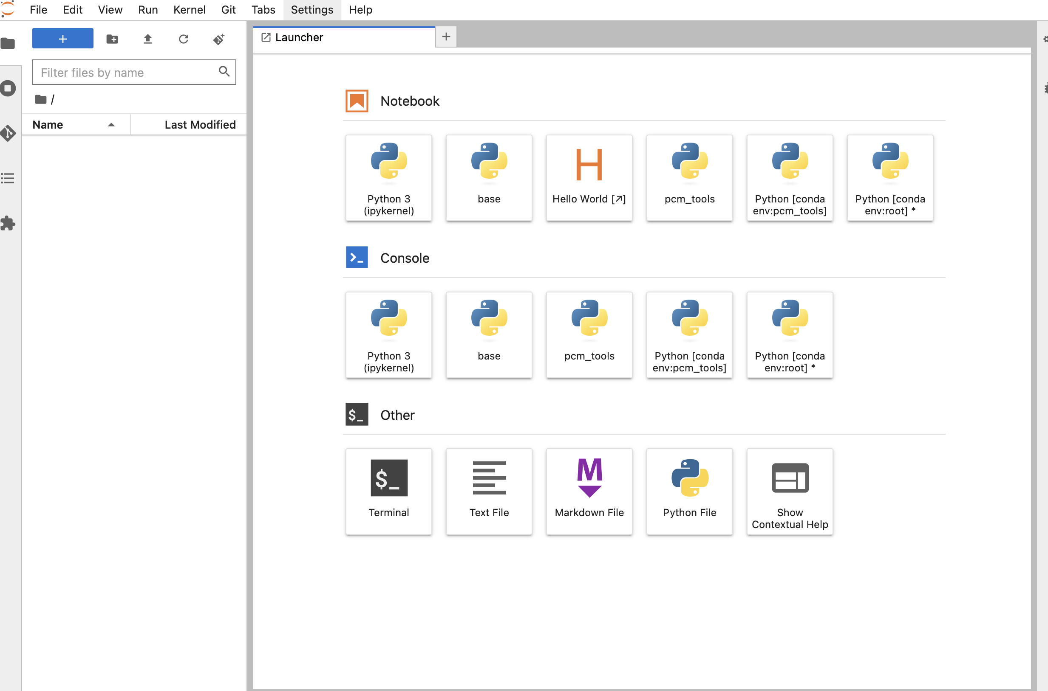
Instruction 3: JupyterLab Home Screen
3.) After the JupyterLab environment loads, it should look something like this:
Note: if you have previously logged in to the on-demand system, Jupyter will take you back to your configuration from when you last logged out.

Slide 7
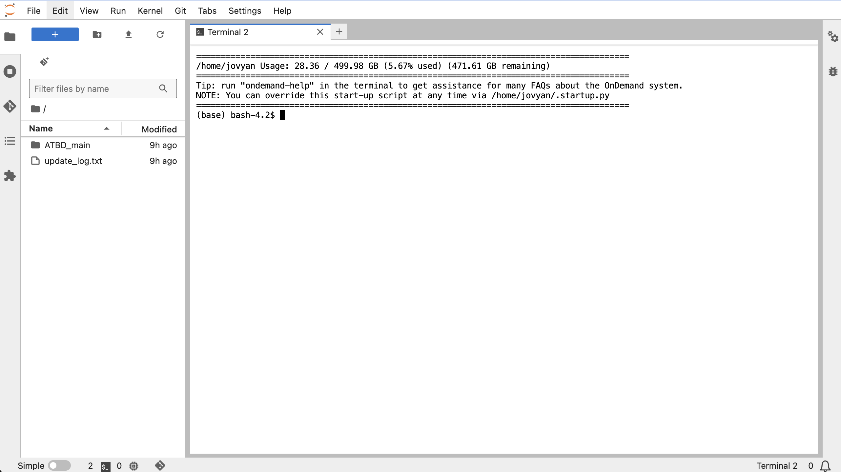
Instruction 4: Open UNIX Terminal
4.) Double click on the terminal icon at bottom left of the panel to open a UNIX terminal window:
Note: the default terminal working directory is whatever is specified in the folder line when the terminal is launched. Prior to step #5, confirm the terminal’s working directory by typing
> pwd
at the terminal prompt. If the response is not /home/jovyan, change the working directory by typing
> cd /home/jovyan
Once you know you’re in the home directory, run the following command:
> ondemand-help install-solid_earth_atbd -g -d
Congratulations! You’re ready to run your notebooks!

Slide 8
Instruction 4.5: First time users only – set up default cal/val configurations
5.) At the terminal prompt, copy my_sites.txt from the ATBD repository to your home directory:
Run the following command:
> cp /home/jovyan/solid_earth_atbd_devATBD_main/my_sites.txt /home/jovyan
Congratulations! You’re ready to run your notebooks!

Slide 9
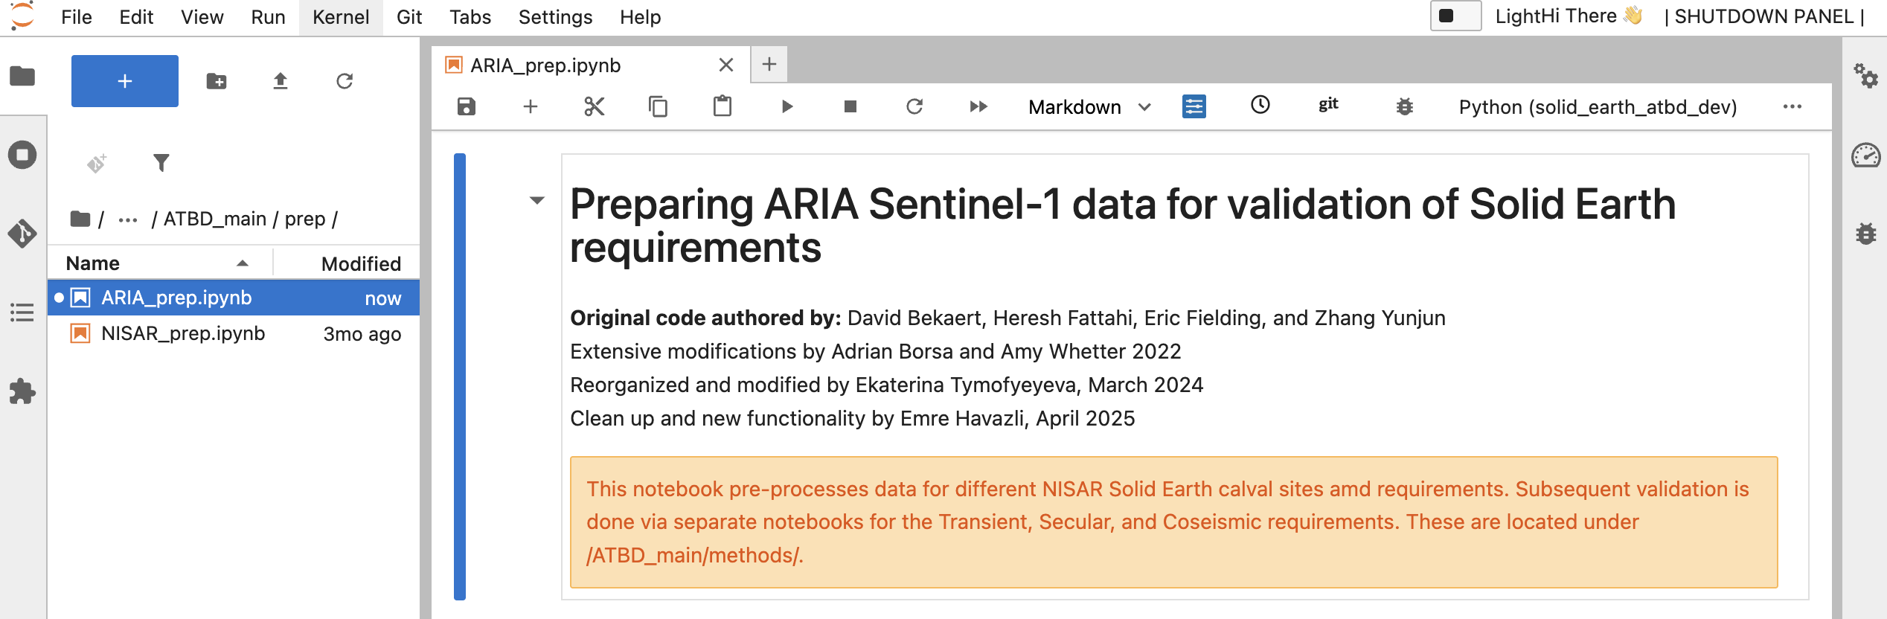
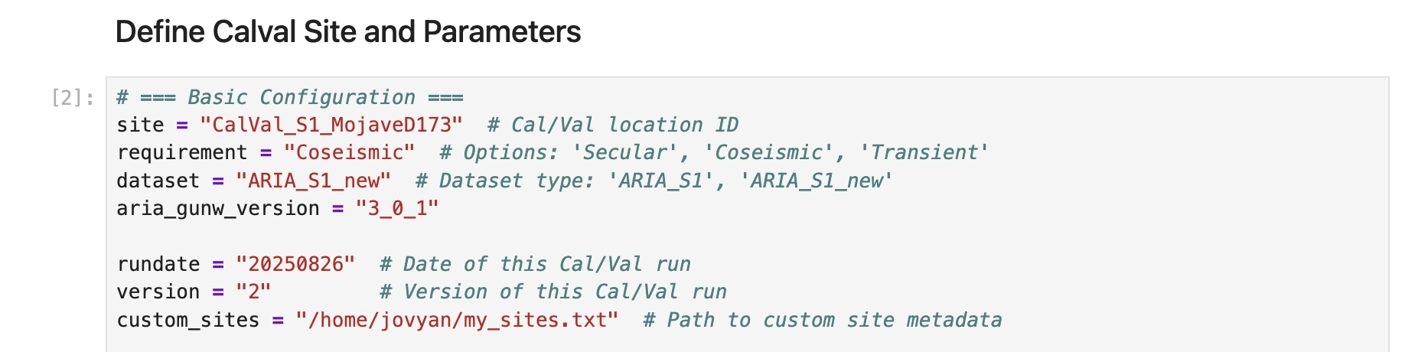
Instruction 5: Run ARIA_prep
5a.) Load ARIA_prep notebook
1.) Go to /ATBD_main/prep/ (under /home/jovyan/solid_earth_atbd_dev/) by clicking on the folders in the window at left
2.) Double-click ARIA_prep.ipynb
3.) Confirm that the kernel is set to solid_earth_atbd_dev. If not, select it from drop-down box at upper right
5b.) Set up the notebook
4.) Enter the calval site name from the my_sites.txt located in your /home/jovyan directory (see Instruction 0 if you don't have one). This will populate a lot of site-specific parameters.
5.) Enter the requirement that is being validated (Secular, Coseismic, Transient)
6.) Enter the current date and validation version, to provide a unique location on /scratch to store notebook output.
5c.) Run notebook
7.) Run the notebook by clicking the >> icon in the menu bar of the ARIA_prep window.

Slide 10
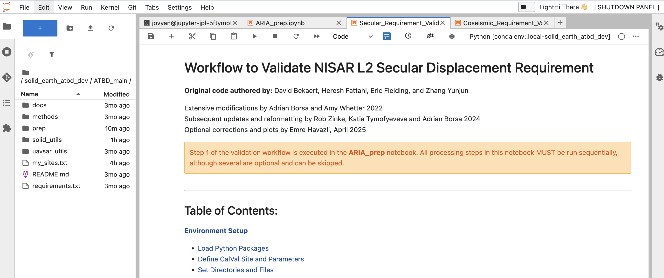
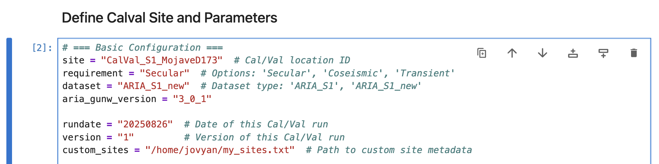
Instruction 6: Run Secular Requirement Validation Notebook
Note: Before running each “method” notebook, rerun ARIA_prep with the corresponding requirement!
6a.) Load Secular_Requirements_Validation 1.) Go to /home/jovyan/solid_earth_atbd_dev/ATBD_main/methods/secular/ by clicking on the folders in the window at left
2.) Double-click Secular_Requirements_Validation.ipynb
3.) Confirm that the kernel is set to solid_earth_atbd_dev. If not, selecting it from drop-down box at upper right
6b.) Set up notebook
4.) Enter validation site name from the my_sites.txt located in your /home/jovyan directory (see Instruction 0 if you don't have this file). This will populate a lot of site-specific parameters.
5.) Enter the date and version number of the data cube that you created earlier with ARIA_prep, which will point to a unique location on /scratch to store notebook output.
6c.) Run notebook
7.) Run the notebook by clicking the >> icon in the menu bar of the Jupyter Notebook window.

Slide 11
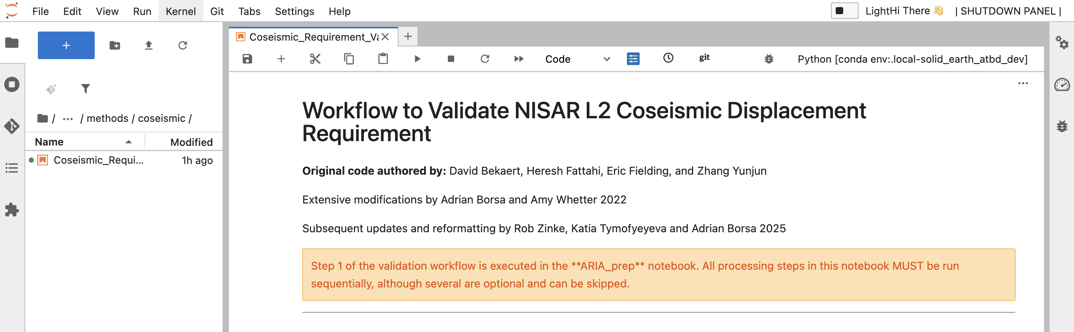
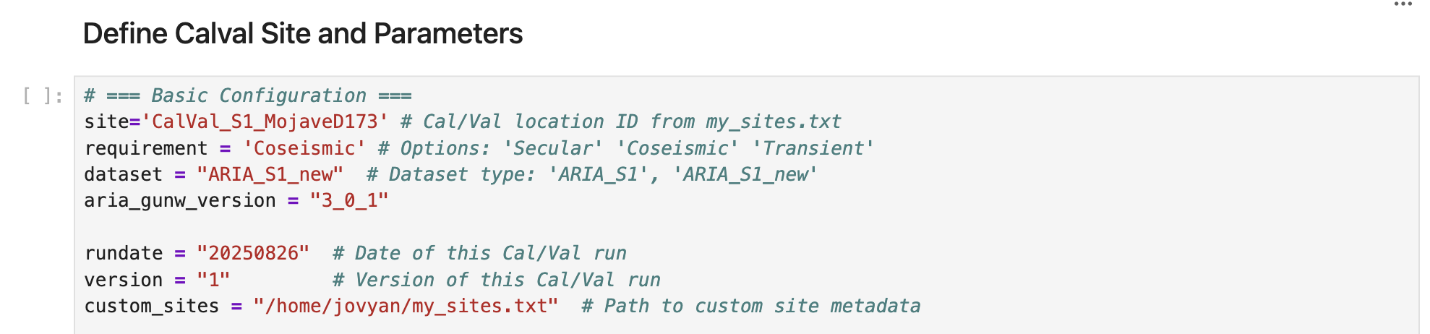
Instruction 7: Run Coseismic Requirement Validation Notebook
Note: Before running each “method” notebook, rerun ARIA_prep with the corresponding requirement!
6a.) Load Coseismic_Requirements_Validation 1.) Go to /home/jovyan/solid_earth_atbd_dev/ATBD_main/methods/coseismic/ by clicking on the folders in the window at left
2.) Double-click Coseismic_Requirements_Validation.ipynb
3.) Confirm that the kernel is set to solid_earth_atbd_dev. If not, selecting it from drop-down box at upper right
6b.) Set up notebook
4.) Enter validation site name from the my_sites.txt located in your /home/jovyan directory (see Instruction 0 if you don't have this file). This will populate a lot of site-specific parameters.
5.) Enter the date and version number of the data cube you created earlier with ARIA_prep, which will point to a unique location on /scratch to store notebook output.
6c.) Run notebook
7.) Run the notebook by clicking the >> icon in the menu bar of the Jupyter Notebook window.

Slide 12
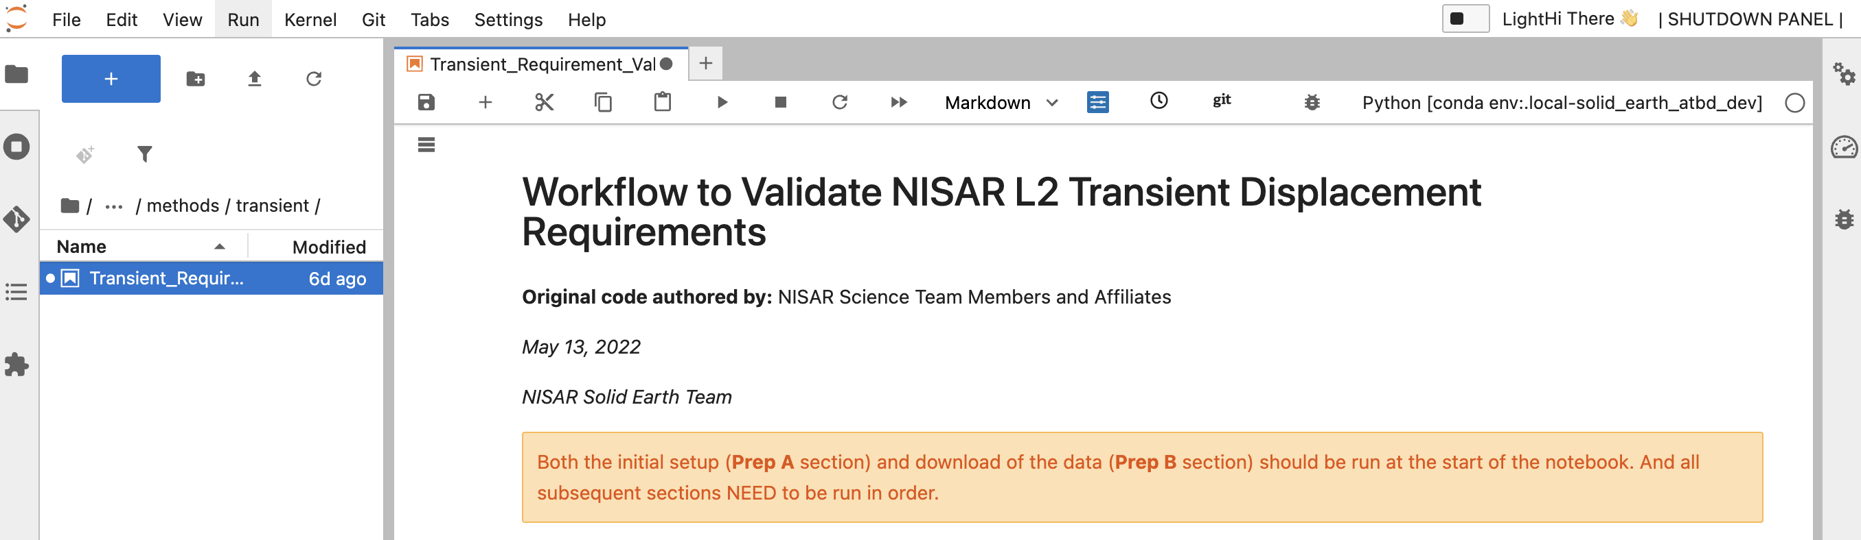
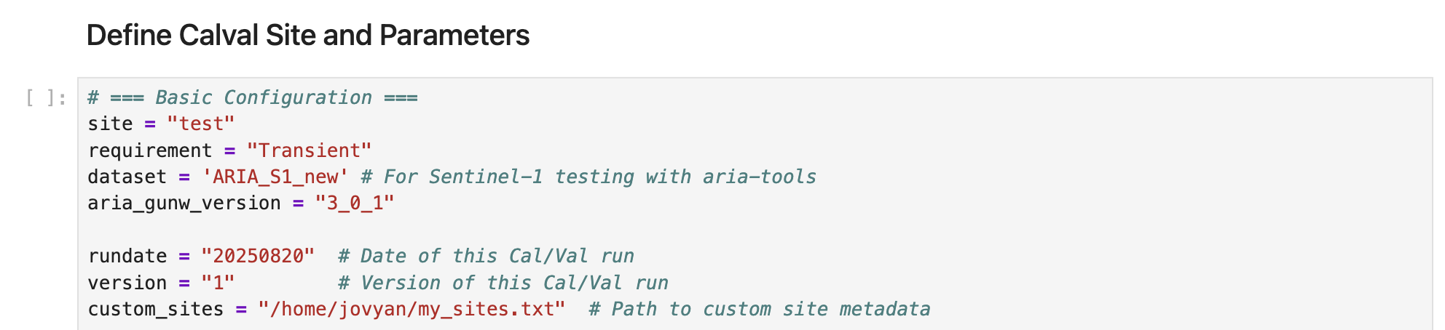
Instruction 6: Run Transient Requirement Validation Notebook
Note: Before running each “method” notebook, rerun ARIA_prep with the corresponding requirement!
6a.) Load Transient_Requirements_Validation 1.) Go to /home/jovyan/solid_earth_atbd_dev/ATBD_main/methods/transient/ by clicking on the folders in the window at left
2.) Double-click Transient_Requirements_Validation.ipynb
3.) Confirm that the kernel is set to solid_earth_atbd_dev. If not, selecting it from drop-down box at upper right
6b.) Set up notebook
4.) Enter validation site name from the my_sites.txt located in your /home/jovyan directory (see Instruction 0 if you don't have this file). This will populate a lot of site-specific parameters.
5.) Enter the date and version number of the data cube you created earlier with ARIA_prep, which will point to a unique location on /scratch to store notebook output.
6c.) Run notebook
7.) Run the notebook by clicking the >> icon in the menu bar of the Jupyter Notebook window.

